Slide 1

Memory Skills Group
Week 5 : Mood and Cognitive Functioning
Rebecca Niebieszczanski (Trainee Clinical Psychologist)
Kirsty Ellis (Assistant Psychologist)
Lesley Stewart (Consultant Clinical Neuropsychologist)
Revised 2019
Anja Steiner (Assistant Psychologist)
Callum Furniss (Trainee Clinical Psychologist)
Gill Cooke (Consultant Clinical Neuropsychologist)

Slide 2

Welcome!
Notes:
Welcome participants to the group
Explain that the group is for individuals who report difficulties with their memory
Important that we have realistic expectations that the group is not about ‘getting rid’ of our memory difficulties
The group will offer skills and information that will help us to manage these memory difficulties
2 hours with break

Slide 3
Overview of the course:
Session 1 Introductions and an overview of cognitive abilities
Session 2 Overview of memory
Session 3 External memory enhancement strategies
Session 4 Internal memory enhancement strategies
Session 5 Mood and cognitive functioning
Session 6 Keeping well, course reviews and goodbyes
Notes:
Today we are going to focus on the interaction between our cognitive functioning and our mood/emotions. We’re going to think about the impact of our mood on our cognitive functioning and vice versa. Along the way we’ll also think of some small changes that we may be able to make, to have a positive impact on the way we feel and how, in turn this might also have a positive impact on our memory and cognition.

Slide 4

Session Outline
Welcome and grounding exercise
Summary of last session
Review of out of session work
Introduction to memory and mood
Memory and mood: our own experiences
Vicious cycles
Out of session work
Summary

Slide 5
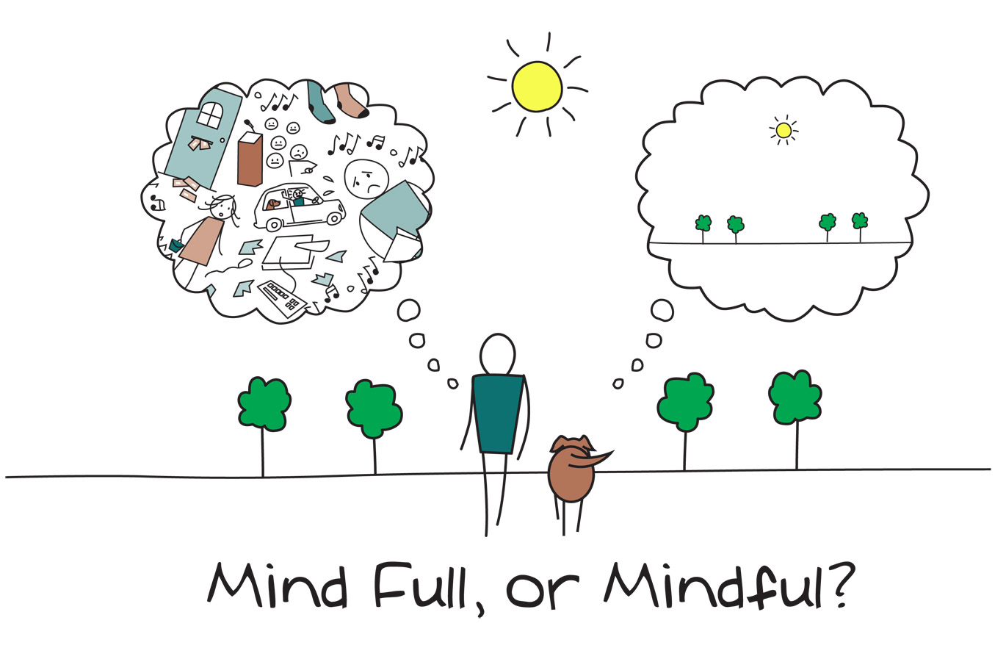
Mindfulness
Notes:
As we said in the last session, when you come into each session there may be lots of things on your mind. You might have thoughts about what you’ve been doing, what you need to do, maybe some expectations or perhaps worries about what the group itself will be like. Our minds often wander and life is sometimes filled with stresses or worries.
To start off today, and at the beginning of our future sessions, we will carry out a brief breathing exercise. The aim of this is just to help us be more present ‘in the moment’, and give us some time to become more aware of our thoughts, feelings and any physical sensations.
As we’ll see later in the course, this can also support our cognitive functioning and help our memory along with promoting overall well-being. If you have difficulty focusing on the breath (e.g. due to breathing difficulties) then go at a pace that feels comfortable to you, stop the meditation or focus on another part of your body, such as your feet.
Below are some of the core principles of mindfulness:
The ‘being’ mode: Mindfulness says that often we are so caught up in these thoughts about the past and future (the ‘doing’ mode) that we end up not paying attention to what’s happening around us now (the ‘being’ mode).
Self-compassion: We often have so much compassion and empathy for others that we forget to have the same for ourselves. Mindfulness is about extending some of this kindness to ourselves.
Mindfulness can have a positive impact on lots of areas of our lives including:
Emotional wellbeing: becoming more aware of our unhelpful thoughts and feelings and distancing ourselves from these. This can help us to realise that thoughts are just that thoughts! We will talk more about this in sessions 5 and 6.
Physical wellbeing: Becoming more aware of our bodies can be very useful for managing stress and reducing the release of cortisols. This is because we’re often not even aware of the impact of stress on our bodies. We will also discuss this in more detail in another session
Cognitive functioning: Mindfulness can be used to help improve our attention. By becoming aware of our thoughts, feelings and physical sensations we can bring our attention back to the present moment and reduce how much time we spend in automatic pilot. This can actually also help us to train our attention and help us to process and encode information effectively.

Slide 6
Last Session: Summary
Overview of internal memory strategies
Practice of internal memory strategy
Weekly goal
Notes:
Home practice: how was it? Any particular difficulties? Anything from previous session? Any strategies noted down?

Slide 7
Reviewing Weekly Goals
Trying out a new memory strategy for the week:
Were you able to do it?
Was it difficult to do?
Was it helpful/unhelpful?
Notes:
Home practice: how was it? Any particular difficulties? Anything from previous session? Any strategies noted down?

Slide 8
Impact of memory/cognitive difficulties on mood Have you experienced any changes? What emotional experiences have these brought up? Does it affect your mood? Does your mood impact on you memory?

